Slide 1
ECE 540 Final Project
Team Progress Report
Binata Bhattacharyya
Brian Dharmanto
Chad Klingbeil
Neil Roberts

Slide 2
Team Members and Ownership
Binata Bhattacharyya VGA Graphics
Brian Dharmanto Verilog Modules
Chad Klingbeil BOT Instructions
Neil Roberts CPU Instructions
Scripting
*NOTE: All team members taking a dynamic role in the development of each area

Slide 3
Expand Project 2 Capabilities
GOAL: Create Driver’s Viewpoint of RojoBot
Enhance Video & Graphics
Screen to show driver’s viewpoint of map
Pseudo-3D imagery to reflect distance of objects
Use RESERVED map setting for trees
Extend BotSim2.0 sensing capabilities to support new requirements
Add long-distance sensors for obstacle-to-display (O2D) imaging
Enhance CPU ROM Instructions to support off-black-line operations
Allow user interaction with push button control when requested, otherwise autonomous control

Slide 4
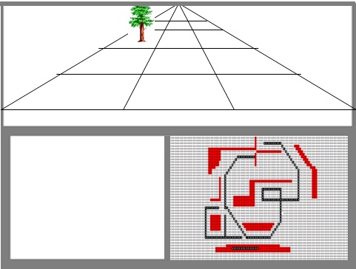


Slide 5
BOT Instructions
Added single long-range sensor (LRProxL, LRProxR) to identify objects that will be display on screen
Defined sensor requirements:
Sensors to detect obstacles at two cells and beyond
  Begin with 4 cells deep (2 bits) Cells 2 – 5 visible
  Step to 8 cells deep (3 bits) Cells 2 – 9 visible
  Up to 16 cells deep (4 bits) Cells 2 – 17 visible
Long-range sensor register configuration:
7 6 5 4 3 2 1 0
LProxL LProxR

Slide 6
BOT Instructions Next Steps
Long-Range Sensor Issue
Insufficient data in a single sensor register for 12 locations containing 1 of 4 possible values
Expand number of long-range sensors to detect objects individually per lane
LRLeft / LRCent / LRRight
  Each sensor to detect objects per lane
  Each sensor register to contain object type and distance
  2 bits to define location (distance)
  2 bits to define object (type: space, black line, obstacle, tree)
7 6 5 4 3 2 1 0
Type RESERVED Distance

Slide 7
CPU Instructions
Enabled dual push button / autonomous control
Push button priority control
  Same control implemented for Project 2
Autonomous control when push buttons not used
  Avoid edge of world
  Avoid obstacles (barriers=2, trees=3)
  Follow black line
Added CPU port to handle single long-range sensor
Scripting
Created perl script to generate COE file from BMP image
File combines COE header with BMP bit data

Slide 8
CPU Instructions Next Steps
Expanding CPU ports to handle new three individual long-range sensors (LRLeft / LRCent / LRRight)
Evaluating quality control of bot actions
Scripting Next Steps
Debug sporadic mis-conversion of BMP2COE pixels

Slide 9
Verilog
Modified Modules
nexys4fpga.v
nexys_bot_if.v
bot.v
world_if.v
Debugged manually generated COE file for POC
Used project 2 and custom icon to show colors and unique design
Created colorizer module to support 4-bit BMP color scale

Slide 10
Verilog Modules Next Steps
Expand modules to Include additional sensors (per lane)
All modules
Colorizer2 to handle extra coloring schemes for world vs bot
BMP2COE conversion script verification / debug
Vivado project development
Unique bot design?

Slide 11
VGA Graphics
Divided 1024 x 1024 display screen into 3 sections
Bot Eye (1024x512)
  Converts bot image size (128x64) to 1024x512
  Uses two images
  Image 1 for orientation = 0/90/180/270
  Image 2 for orientation = 45/135/225/315
Wheel Icon (512x512)
  Converts bot image size (64x64) to 512x512
  Uses two images
  image 3 for orientation = 0/90/180/270
  Image 2 for orientation = 45/135/225/315
World Map (512x512)
  Uses world map for right end corner 512x512
Bot Eye (1024x512)
Wheel icon
(512x512)
World Map
(512x512)

Slide 12
VGA Graphics Next Steps
Display 1024 x 1024 BMP2COE converted image on screen
Display 512 x 512 World Map image from Project 2 in lower right corner of full display
Display 512 x 512 Control Console (Steering Wheel, etc.) in lower left corner
Add trees (value=3) to world map
Run map file through script to create COE for ROM build
Verify map conversion via display

Slide 13
End

